Slide 1
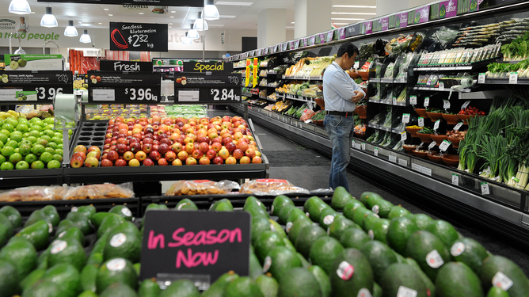
Fresh Findings Ltd. Case Study:
Prepared by:-
Dhrubojyoti Das || NIT Jamshedpur

Slide 2
SUMMARY:
About the Company
Problem
Our Approach
Fresh Findings Ltd. is a go-to organization for the clean meals demands. With this type of incredible achievement withinside the clean meals market, the organization has determined to make bigger its commercial enterprise withinside the gold merchandise market.
They have commenced providing gold for the last 2 years and has gotten appropriate mixed feedbacks. Now, because of those reasons, the organization has determined to do an evaluation of the client facts to apprehend the client conduct and as a result desires to enhance its services.
This case observe, offers insights primarily based totally at the client facts of remaining 2 years, how client conduct is in line with their demographics. Finally, we finish the case observe via way of means of giving the effects we gathered from the given facts in sorts of Tables, Charts & Graphs giving answers to the given responsibilities and giving our proposal on how the business enterprise ought to method the prevailing situation to preserve a success commercial

Slide 3
Methodology:
Data Collection
Collected the data from the case study document it self.
Used PYTHON and EXCEL for all the operations.
Data Cleaning
The data consisted of spelling mistakes, wrong data type of fields, empty cells & duplicates.
Used PANDAS libraries of PYTHON to clean the data.
EDA
Added columns using the existing data for analysing the data and making visualizations.
Used PIVOT TABLES, PIVOT CHARTS & SEABORN for data visualizations.
Conclusion
Use the tables and graphs to solve the given tasks.
Use the findings from the graphs and tables to make reasonable decisions.

Slide 4
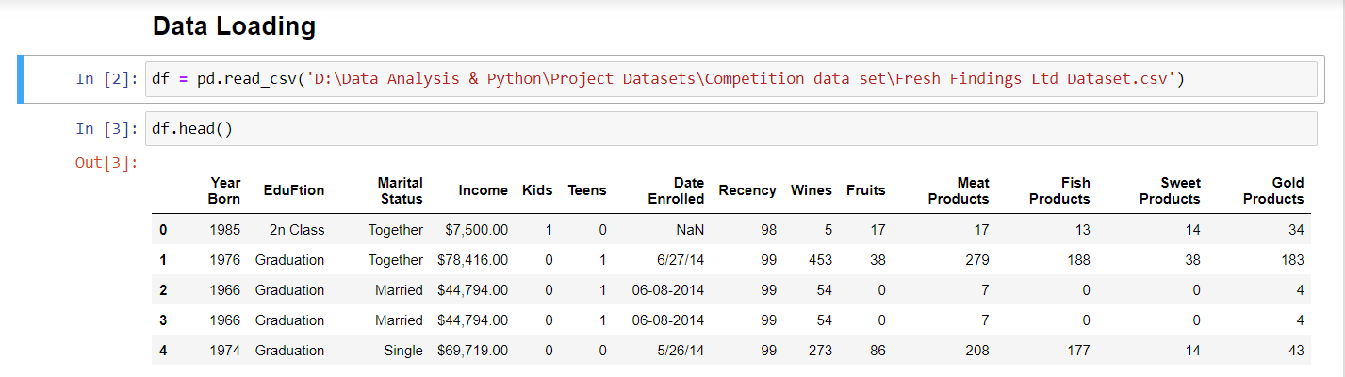
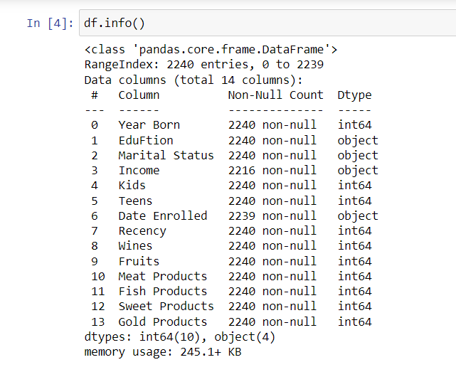
DATA COLLECTION:
Findings we are getting from here:-
Name of Education column is not correct.
Data type of few columns are not correct.
Income column has null values.
Data type of income field is not correct.
Income field contains '$' and ',' signs.
Date Enrolled column has null values.
Data set contains duplicate data.
Data set contains wrong spellings.

Slide 5
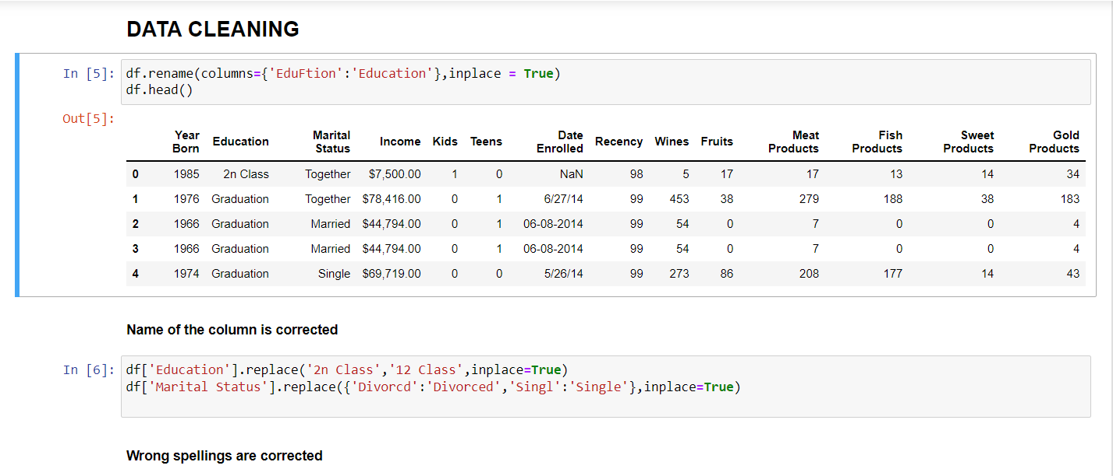
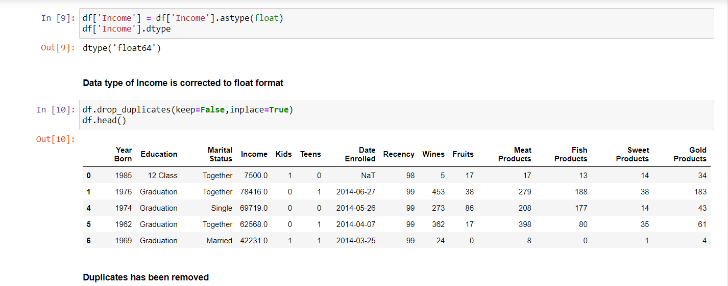
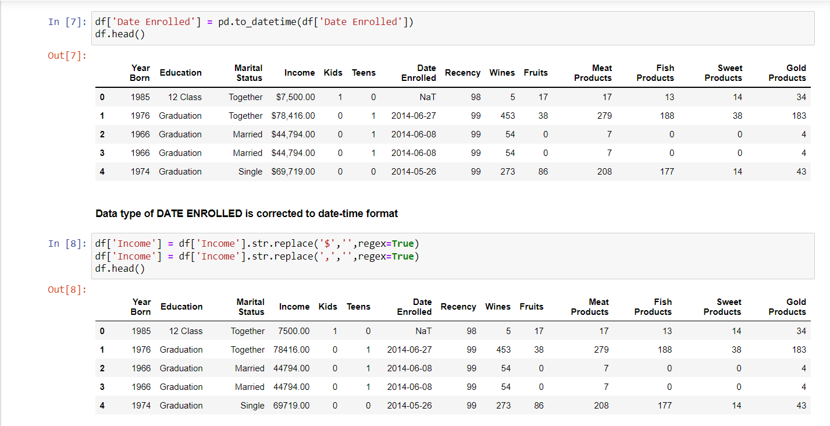
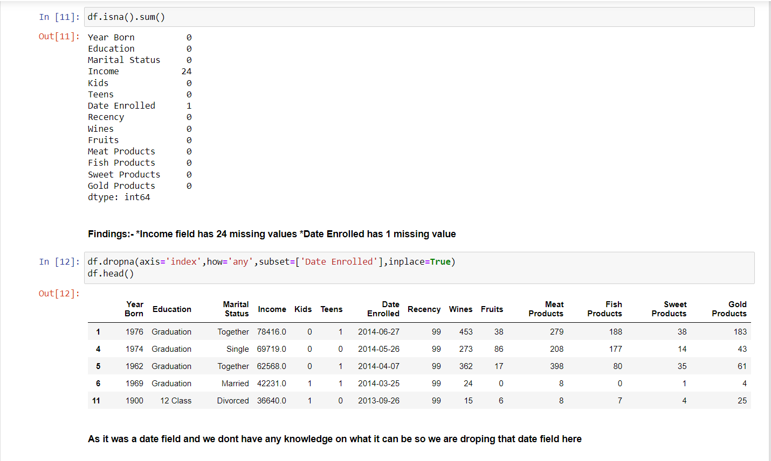
DATA CLEANING:

Slide 6
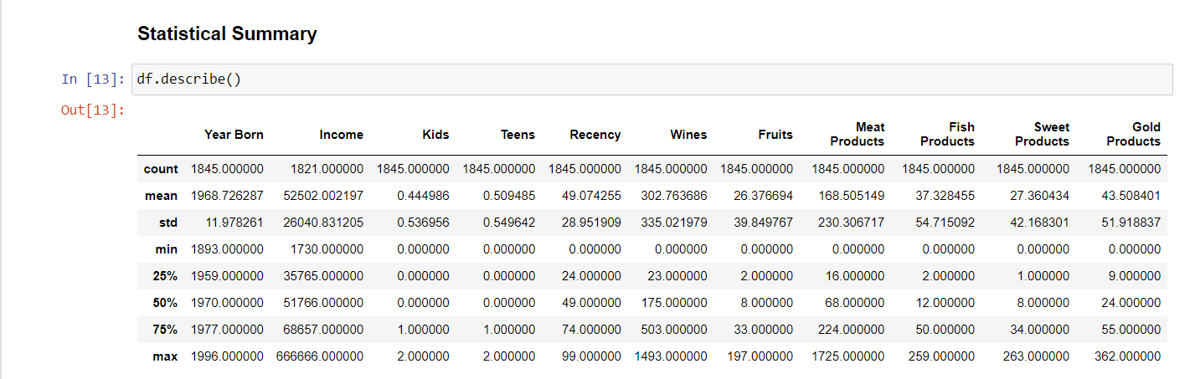
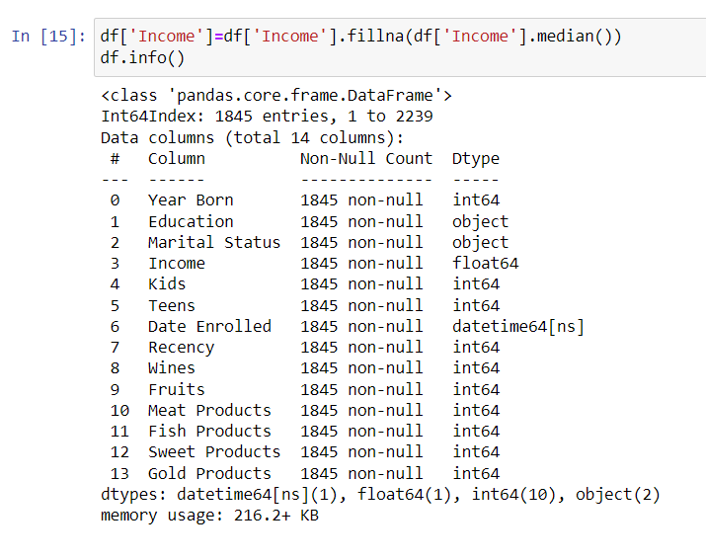
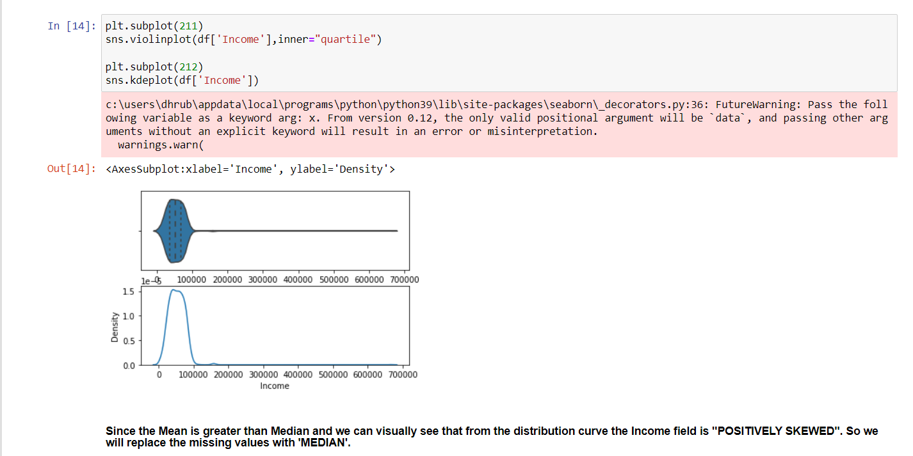
With this all the spelling mistakes, empty cells, duplicates are removed from the data.

Slide 7
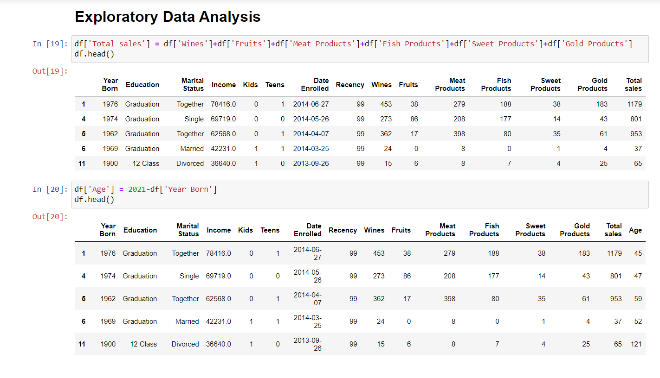
EDA:
With this we have added 2 new columns for better analysis of the data.

Slide 8
Task 1: comparison Between Avg. income of people and their educational background:
Education | Average of Income
Basic | 19431.13636
12 Class | 47266.44048
Master | 53134.7549
Graduation | 53241.08082
PhD | 56104.86216
Yes, the salary of PhD holders statistically diff. from master’s degree holder. Its greater.

Slide 9
comparison Between educational background of people and the avg. amount these people spend on gold products:
Education | Average of Gold Products
Basic | 22.65909091
PhD | 32.53383459
Master | 41.19607843
12 Class | 43.7797619
Graduation | 49.92887931
No, its not true that people with higher education level earn more but still on an avg. spend less on gold.

Slide 10
Marketing Strategy for selling gold products to each group:
Firstly, segment the audience based on their education and use diff. marketing strategy for each segment.
For people with higher education and better salary for them we can make marketing campaign such that its gold can be a good way to have a better living standard and to show case a social status and good symbol in the society.
For people with not so significant or no higher education the marketing campaign can target on how gold can be a good invest for there future and gives them a good social status.

Slide 11
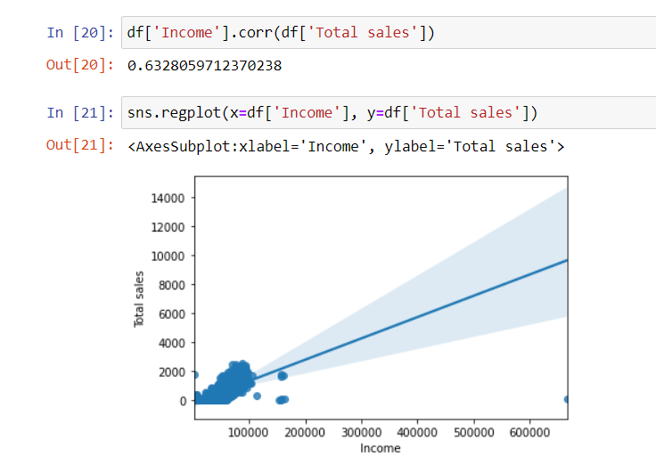
TASK 2: correlation between the annual income and the amount of spending in the last 2 years:
From the graph we can see a positive and statistically significant correlation between income and expenses i.e., with increasing in income the amount spend increases.
With this knowledge we can make diff. marketing strategy for diff. segments. Apart from this we can adjust our prices to make it more lucrative for the low-income segment.
Yes, its feasible for Fresh Findings to target high annual income customers.
The correlation between the annual income and the amount of spending in the last 2 years 0.6328059712370238.

Slide 12
TASK 3: relation between expenditure on wine & Married and educated people:
Education | Average expenditure on Wines
Basic | 18.375
12 Class | 133.1052632
Graduation | 278.2128852
Master | 328.4836066
PhD | 413.6036585
Yes, the assumption is TRUE. From the graph & table we can see with increase in educational level of the married people the avg. expenditure on wine increases.

Slide 13
whether Educated and Married Customers are independent:
Education | Divorced | Married | Single | Together | Widow | Grand Total
Basic | 9548 | 21366.375 | 18238.66667 | 19142.625 | 22123 | 19431.13636
12 Class | 51131.52381 | 43301.33333 | 53622.37838 | 44954.89583 | 51392.2 | 47266.44048
Master | 52204.36667 | 53787.4918 | 51471.37931 | 52740.10976 | 57848.58333 | 53134.7549
Graduation | 53884.73333 | 51516.40616 | 51847.03271 | 56363.42152 | 58545.96296 | 53241.08082
PhD | 53629.69231 | 57914.62195 | 52978.67857 | 56398.09677 | 59177.33333 | 56104.86216
Grand Total | 53055.59184 | 52041.15503 | 50713.23114 | 53854.03304 | 57447.61905 | 52492.42818

Slide 14
whether Educated and Married Customers are independent:
Education | Divorced | Married | Single | Together | Widow | Grand Total
Basic | 9548 | 21366 | 18239 | 19143 | 22123 | 19431
12 Class | 51132 | 43301 | 53622 | 44955 | 51392 | 47266
Master | 52204 | 53787 | 51471 | 52740 | 57849 | 53067
Graduation | 53885 | 51516 | 51847 | 56363 | 58546 | 53234
PhD | 53630 | 57915 | 52979 | 56398 | 59177 | 56156
Grand Total | 53055.59184 | 52041.15503 | 50713.23114 | 53854.03304 | 57447.61905 | 52485.01739
As we can see from here not just married but anyone with more higher education gets financially independent.

Slide 15
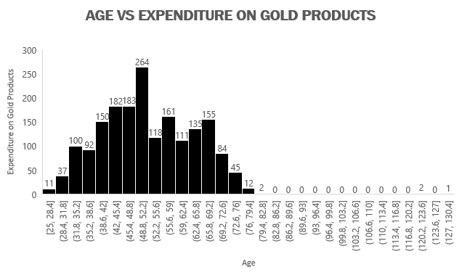
Task 4: Avg. expenditure on gold products by people of diff. age group:
From this we can see we have low penetration in the 25-40 years age segment so to make it more lucrative and get higher penetration we can give them the 10% discount.
Apart from this we can give additional discounts or incentives for the people of the age bracket 40-60 years to improve customer loyalty, increase customer retention and for word-of-mouth Marketing.

Slide 16
Conclusion:
The quality of data collected by Fresh Findings Ltd. must be improved as the data contained loads of error and wrong data can often lead to mis-leaded insights hence bad decisions.
They should follow diff. marketing & pricing strategies for people with diff. income levels to increase their customer reach.
The new Gold product segment is doing good with middle aged people(i.e. people in 40s & 50s) but not so good among people in mid 20s and 30s. The company needs to come up with various marketing strategies like Influencer marketing, discounting, Instagram marketing, etc. targeting the specific audience for better response.

Slide 17

Thank you! Presented by: Dhrubojyoti das | Nit Jamshedpur dhrubojyotidas6075@gmail.com 8757197111

